Slide 1
Network Detective
BCSE308P · COMPUTER NETWORKS · FALL 2026–27
A self-healing network that finds a failure, reroutes the traffic and proves the fix worked, in about three seconds.
PV Sai Likith
B. Naveen
M. Nayan
24BCI0174
24BCE0512
24BCE0538
Notes:
Good morning. We are presenting Network Detective, a self-healing network monitor. In one sentence: when a link or a device fails, our system notices it, works out what broke, moves the traffic to another path and then tests that path to prove the fix worked, all in about three seconds and without anyone touching it. I am Sai Likith, with Naveen and Nayan.

Slide 2
When a link fails today, a person has to fix it
THE PROBLEM
1. Notice
2. Diagnose
3. Reroute
Monitoring tools poll every few minutes, then send an alert to someone.
One crashed router raises an alarm for every wire. An engineer works out the cause.
Routes are changed by hand, and someone checks that the new path works.
Traffic stays down for that whole time. Small campus and office networks often have nobody watching.
Notes:
Here is the problem. In a normal network, when a link or a router fails, three things have to happen, and a person does all of them. First someone has to notice: monitoring tools such as Nagios or Zabbix check devices on a polling interval, often minutes by default, and then send an alert. Second, someone has to diagnose it. When one router crashes, every wire connected to it also looks broken, so the engineer gets a flood of alarms and has to work out which one is the real cause. Third, someone has to reroute the traffic by hand and then check the new path actually works. Users are cut off for that entire time. And small networks, like a college lab or an office, often have no engineer watching at all. Our project automates all three steps.

Slide 3
Six goals, each met with a measured result
OBJECTIVES
Objective | Evidence from the running system
Monitor every device and link continuously | Probed every 0.5 s (simulation), 1 s (live)
Detect failures, high latency and loss | Link cut confirmed in 1.2 s
Find the exact failed component | 11 of 11 failure kinds named correctly
Compute an alternate path | Stored detour found in 0.01–0.02 ms
Reroute without human input | Applied 5–11 ms after detection
Verify that connectivity is restored | 30 of 30 simulated, 5 of 5 live detours verified
Notes:
These were the objectives we set in Review 1, and on the right is the evidence from the running system for each one. We monitor every device and link, every half second in simulation and every second on real devices. A cut link is confirmed in 1.2 seconds. The diagnoser named the right component in all eleven kinds of failure we tested. A detour is found in hundredths of a millisecond because it is stored in advance. The reroute is applied within about 5 to 11 milliseconds of detection, with no human involved. And finally every detour is tested: 30 out of 30 in simulation and 5 out of 5 on real devices passed verification.

Slide 4

One closed loop that runs without a person
OUR SOLUTION
Detect
Diagnose
Heal
Verify
3 bad probes in a row
Name the real cause
Move traffic to a detour
Test every hop, or undo
1.2 s
milliseconds
5–11 ms
done at 3.25 s
When the failed part is repaired, traffic fails back to its normal route and the incident closes itself.
Notes:
This is the core idea of the project: one closed loop with four steps. Detect: the monitor confirms a failure after three bad probes in a row, which takes about 1.2 seconds in simulation. Diagnose: the system works out the real cause, for example that a router crashed rather than five separate wires. Heal: it moves every affected route to a detour, which takes only 5 to 11 milliseconds. Verify: after a short wait it tests every hop of the new path, and if the path is bad it undoes the change and alerts an engineer. From the moment of failure to a verified fix takes 3.25 seconds in simulation. And when the broken part comes back, the traffic automatically moves back to its normal route. Each of us built one part of this loop, which we will explain next.

Slide 5
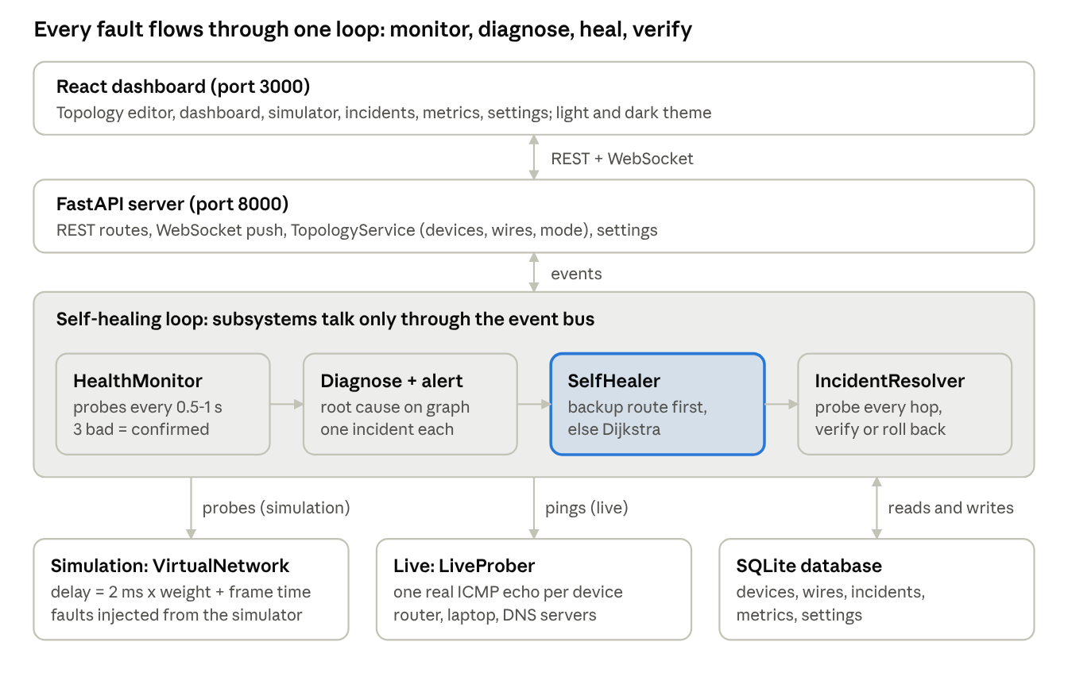
Modules talk through one event bus
ARCHITECTURE
Each module publishes an event and the next one reacts:
FAULT_DETECTED
monitor → detector
HEALING_COMPLETE
healer → verifier
VERIFICATION_RESULT
verifier → dashboard
The database is the single source of truth for the network.
Notes:
This is the architecture. On top is the React dashboard, which talks to a FastAPI server over normal web requests and a WebSocket for live updates. Inside the server, the modules do not call each other directly. Each one publishes an event on an internal event bus, and the next module reacts to it. The health monitor publishes fault detected; the detector and healer pick it up and publish healing complete; the verifier tests the new path and publishes the verification result, which the dashboard shows live. This makes each module easy to test on its own. All devices, wires, incidents and metrics are stored in an SQLite database, which is the single source of truth: the network you draw in the editor is the network that is monitored. Underneath, the monitor talks either to the simulated network or to real devices.

Slide 6
Chosen for tested algorithms and live updates
TECHNOLOGY
Layer | Technology | Why
Server | Python, FastAPI, Uvicorn | Runs many probes at once (async)
Graph | NetworkX | Proven Dijkstra and graph tools
Real pings | ping3 (ICMP) | Works without admin rights
Storage | SQLAlchemy, SQLite | No setup; swap for PostgreSQL
Dashboard | React, TypeScript, Tailwind | Live view over a WebSocket
Testing | pytest | 48 tests, incl. end-to-end
Notes:
Our technology choices. The server is Python with FastAPI, which is asynchronous, so it can probe many devices at the same time without waiting on each one. For the network graph and shortest paths we use NetworkX, a well-tested library, rather than writing Dijkstra from scratch. Real pings use the ping3 library, which sends ICMP echo requests and works without administrator rights on macOS. Data is stored with SQLAlchemy in SQLite, which needs no setup, and the same code works with PostgreSQL for a bigger deployment. The dashboard is React with TypeScript and Tailwind, and it receives updates live over a WebSocket, so it changes the moment a fault happens. Everything is covered by 48 automated tests written with pytest.

Slide 7
The monitor ignores one lost packet
MODULE 1 · DETECT · PV SAI LIKITH
Probe every device and wire, every 0.5 s (simulation) or 1 s (live)
1.2 s
Measure latency, packet loss, and jitter between replies
Confirm only after 3 bad probes in a row
link cut confirmed (simulation)
Announce a FAULT_DETECTED event to the detector
6.2–6.5 s
real device switched off (live)
Notes:
Module one, detection, built by Sai Likith. The health monitor probes every device and every wire on a timer: every half second in simulation and every second on real devices. From the replies it measures latency, packet loss and jitter, which is how much the latency changes between replies. The important design decision is confirmation. On a real network single packets get lost all the time; in our own measurements about 8 percent of pings to Google DNS took over 200 milliseconds. So we only call a device down after three bad probes in a row. That costs about a second, and it stops us rerouting traffic for no reason. Once confirmed, the monitor announces a fault-detected event. A cut link is confirmed in 1.2 seconds in simulation, and when we switched off a real device it was detected in 6.2 to 6.5 seconds.

Slide 8
The detour is chosen before the failure
MODULE 2 · DECIDE · B. NAVEEN
Classify over 200 ms or 10 % loss is critical; a z-score flags unusual readings
0.003 ms
Root cause a crashed device explains all its broken wires: one incident
Backup table a stored detour for every route and every part on it
stored detour lookup (200 devices)
Fallback Dijkstra on the healthy network if two things fail
0.39 ms
fresh Dijkstra, same network
Notes:
Module two, deciding, built by Naveen. First the detector classifies each reading: over 200 milliseconds or 10 percent loss is critical, and a z-score check compares each reading with the device’s last 30 readings to catch something unusual even before it crosses a fixed limit. Then root cause: when a router crashes, all its wires also look broken, so the diagnoser groups them and raises one incident for the router. For the path, we use the same idea as fast reroute in real routers: for every route and every link or device on it, the detour is computed in advance and stored. When a failure happens, choosing the detour is just a lookup: 3 microseconds at 200 devices, compared with 0.39 milliseconds for a fresh Dijkstra run. If two things fail at once and the stored detour is not usable, we fall back to Dijkstra on whatever is still healthy.

Slide 9
A reroute only counts once it is tested
MODULE 3 · HEAL & VERIFY · M. NAYAN
Reroute every affected route moves to its detour
5–11 ms
Settle, then test wait 2 s, then probe every hop of the new path
Pass or roll back pass at ≤ 300 ms and ≤ 15 % loss; otherwise undo and escalate with the reason
to choose and apply the detour
3.25 s
Fail back return to the normal route after repair
failure to verified fix (simulation)
Notes:
Module three, healing and verification, built by Nayan. The self-healer moves every route that used the failed part onto its detour; choosing and applying it takes 5 to 11 milliseconds. But changing a route is not the same as fixing the problem, so the verifier waits two seconds for the network to settle and then tests every hop of the new path. It passes if every hop is under 300 milliseconds and 15 percent loss, which is one and a half times our critical limits, because a path that just changed deserves a little grace. If it fails, we undo the change so traffic is never left on a bad path, and we escalate to an engineer with the reason, for example “switch-c is down and cuts off server-e”. When the failed part is repaired, traffic fails back to its normal route. From the moment of failure to a verified fix takes 3.25 seconds in simulation.

Slide 10
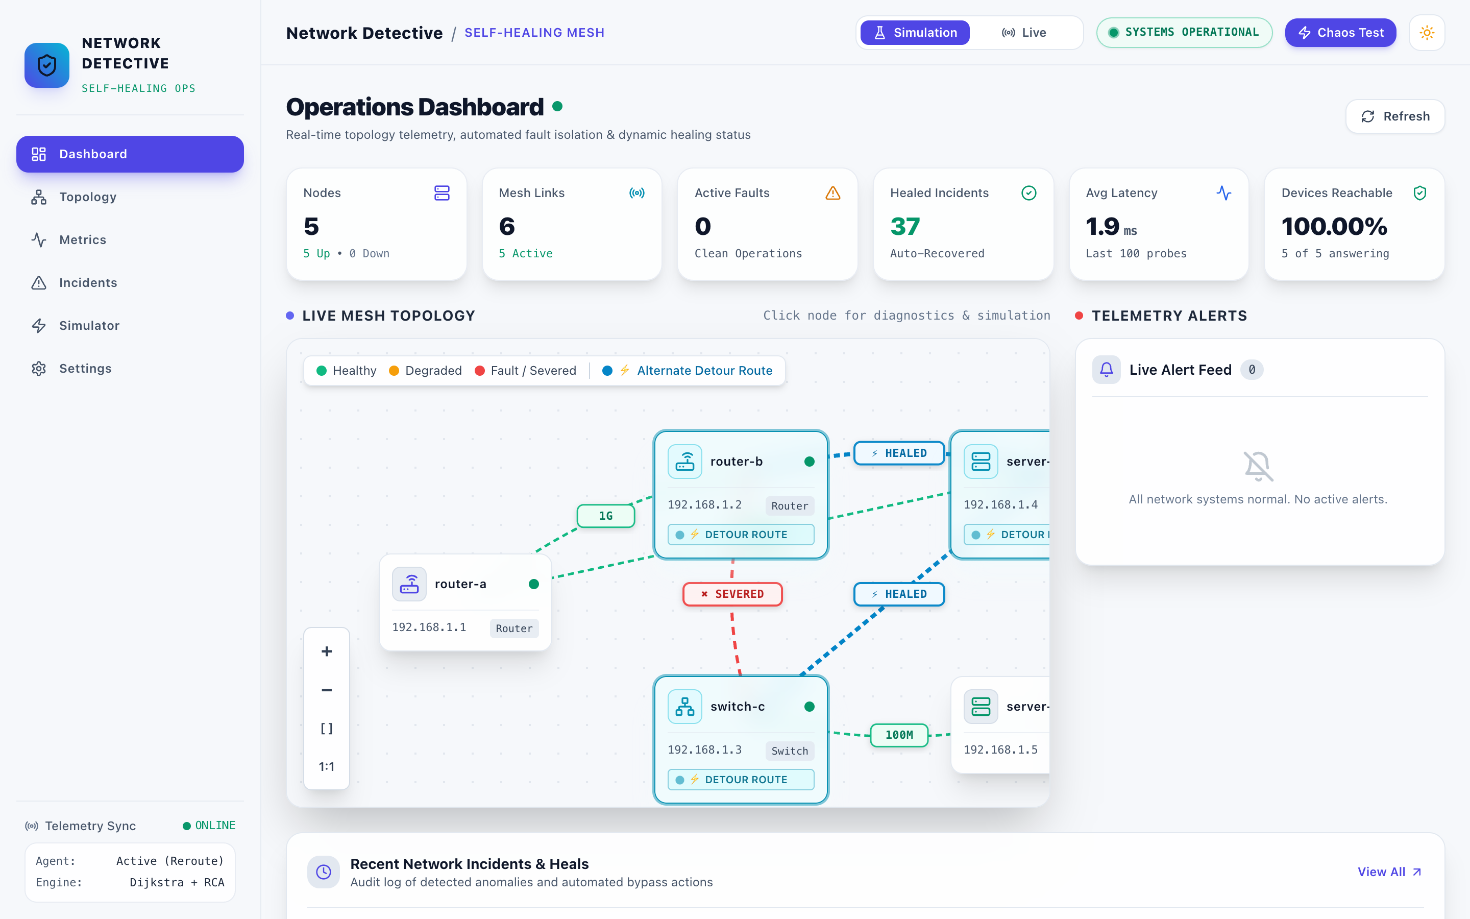
Every fault and fix, as it happens
THE DASHBOARD
Topology
red for the broken link, green for the detour
Incidents
a timeline: detected, diagnosed, rerouted, verified
Metrics
latency, loss and jitter per device
Simulator
cut a link or crash a router on purpose
Notes:
This is our dashboard, taken right after a link was cut. The topology view shows the broken link in red and the detour the system chose in green. The incidents page shows a timeline for every failure, built from the real incident data: when it was detected, what the diagnosis was, which route was applied and whether verification passed. The metrics page charts latency, loss and jitter for every device. And the simulator page lets us break the network on purpose, for example cut a link or crash a router, which is what we will use in the demo. Everything updates live over a WebSocket, so nobody has to refresh. The dashboard also has light and dark themes.

Slide 11
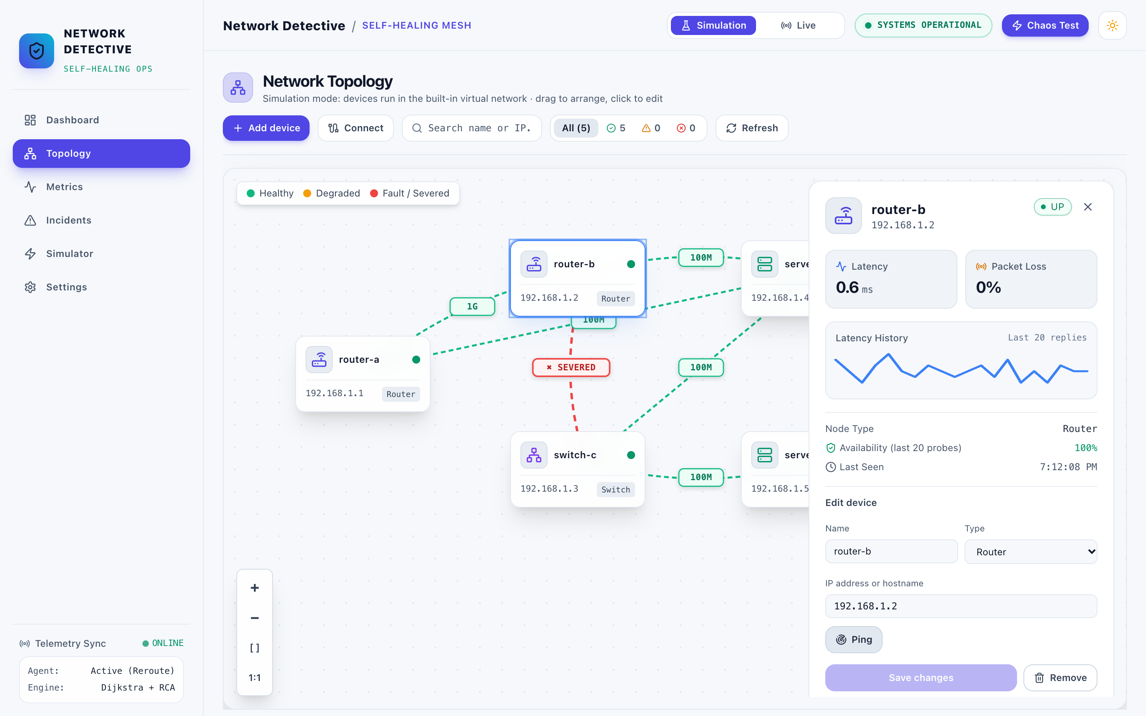
Draw your own network, then ping it for real
LIVE MODE
Add devices
servers, routers, switches with a real IP address
Connect wires
drawn in the editor, saved in the database
Real pings
router 5.9 ms, Google DNS 44.5 ms median
Real healing
wire cut rerouted via Cloudflare in 4.5 s
Notes:
Besides the simulation, the system has a live mode. In the topology editor you can add servers, routers and switches, give each one a real IP address, test it with a ping, and draw the wires between them. Everything is saved in the database. In live mode the monitor sends real ICMP pings every second, so the readings are real: over 615 pings each, our router answered in 5.9 milliseconds median and Google DNS in 44.5. When we cut the wire to Google DNS in the editor, the system rerouted through Cloudflare DNS within about 4.5 seconds and verified the detour with real pings, in 5 out of 5 runs. To be clear about the limits: the wires are the ones we draw, and the reroute changes our application’s routing table, not the configuration of the physical router.

Slide 12
Every test run ended correctly
RESULTS
3.25 s
6.53 s
48 / 48
failure to verified fix, simulation
failure to verified fix, real devices
automated tests pass
55 / 55
10 / 10
615
simulated runs correct: 30 healed, 25 escalated
live runs on real devices correct
real pings per device measured
Notes:
Our results. From the moment of failure to a verified fix takes 3.25 seconds in simulation and 6.53 seconds on real devices. All 48 automated tests pass, including end-to-end tests that inject a failure into the running server. We ran 55 failures in simulation and every one ended with the correct outcome: 30 were healed and verified, and 25 were correctly escalated because no detour existed, for example when the only switch to a server crashed. Escalating with the right reason is the correct answer in those cases, because no software can route around a missing path. All 10 runs on real devices were also correct. And to make sure our live numbers are real, we measured 615 pings to each device over about 20 minutes.

Slide 13
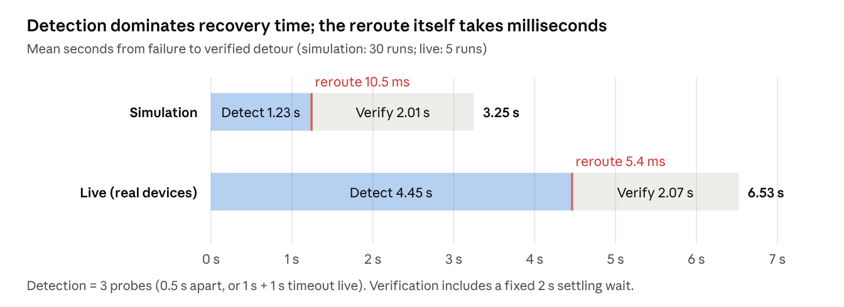
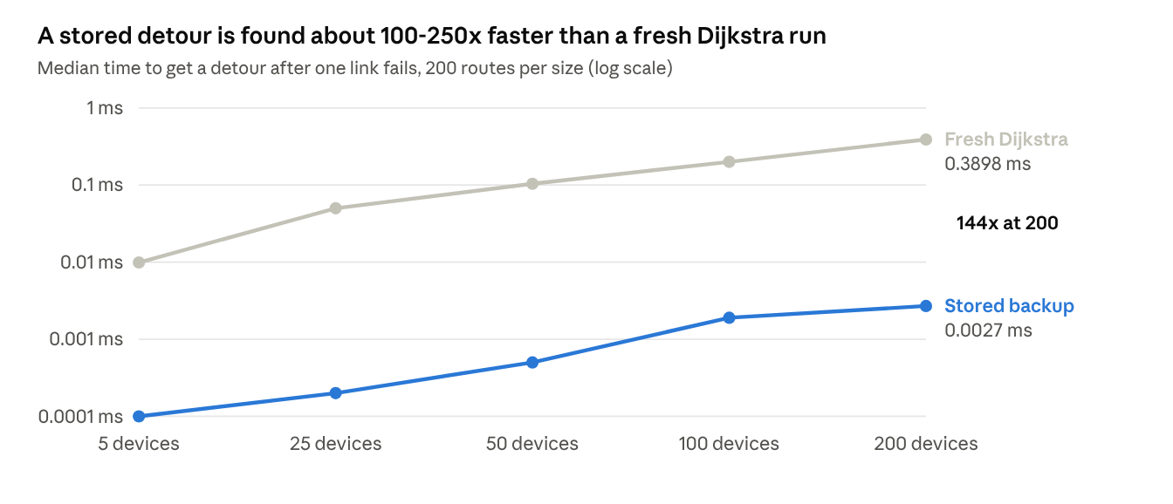
The safety waits take the time, not the reroute
PERFORMANCE
Recovery time: confirmation and the 2 s wait dominate; choosing the detour takes 5–11 ms.
Fast reroute: a stored detour is about 100–250× faster than a fresh Dijkstra run.
Notes:
Two charts on performance. On the left is where the recovery time goes. Almost all of it is the three-probe confirmation and the fixed two-second settling wait before verification. Choosing and applying the detour itself takes only 5 to 11 milliseconds. Those waits are deliberate: they prevent false alarms and make sure we only call a fix verified once the path has settled. On the right is the benefit of storing detours in advance. Looking up a stored detour stays near a microsecond as the network grows, while a fresh Dijkstra run grows with the network, so the lookup is between about 100 and 250 times faster. The trade-off is building the table, which takes 1 millisecond for our campus network but grows quickly for very large networks.

Slide 14
Existing tools stop at the alert
COMPARISON WITH EXISTING SYSTEMS
Step | Nagios, Zabbix, PRTG | Network Detective (measured)
Detect | On a polling interval | 1.2 s after the cut
Find the cause | Engineer reads alerts | Diagnoser names the failed part
Restore traffic | Engineer reroutes by hand | Detour applied in 11 ms
Confirm the fix | Engineer checks | Every hop tested; verified at 3.25 s
Unfixable failure | Same alert as any other | Escalated with what is cut off
After repair | Engineer restores routes | Fails back automatically
Notes:
How does this compare with existing systems? Tools such as Nagios, Zabbix and PRTG are very good at detection, on their polling interval, but after the alert everything else is done by a person: reading the alerts to find the cause, rerouting by hand, checking the fix and restoring the routes after the repair. To compare fairly, we ran the same link cut with self-healing switched off, which makes our system behave like an alert-only tool, and then switched on. With healing off, the fault was detected just as fast, but traffic stayed down until someone acted. With healing on, the detour was applied 11 milliseconds after detection and verified 3.25 seconds after the cut. For failures that cannot be fixed, we do not just send the same alert: we say exactly what is cut off. We did not time a human response, so we do not claim a number for it.

Slide 15
What we would build next
LIMITATIONS AND FUTURE SCOPE
Real network equipment
Larger networks
Today a reroute changes our routing table. Next: push it to routers over SNMP or NETCONF.
The backup table takes 3.7 s at 50 devices, 370 s at 200. Next: update only what changed.
Devices that block ping
Predict before it fails
They show as down today. Next: probe a TCP port or read SNMP counters.
Learn from stored latency history to move traffic before a link fails.
Notes:
We want to be honest about the limits and where we would take this next. First, real equipment: in live mode the readings are real, but the reroute changes our application’s routing table, not the router’s configuration. The next step is to push the new route to real routers using SNMP or NETCONF. Second, larger networks: the backup table is built for every route and every part on it, which is instant for a campus but takes 3.7 seconds at 50 devices and 370 seconds at 200, so we would update only the routes affected by a change. Third, some devices block ping and would appear as down; probing a TCP port or reading SNMP counters would fix that. Finally, since we already store latency, loss and jitter history, a model could learn the warning signs and move traffic before a link actually fails.

Slide 16
Thank you
NETWORK DETECTIVE
Detect in 1.2 s, reroute in milliseconds, verified in 3.25 s. Questions?
Source code
github.com/likithtech2006-pixel/network-detective
Notes:
To sum up: Network Detective closes the loop that today needs a person. It detects a failure in about 1.2 seconds, moves the traffic in milliseconds, and proves the fix worked by testing every hop, all within about 3.25 seconds, and it rolls back and explains itself when it cannot fix something. The full source code is public on GitHub at the link on the slide. Thank you, and we are happy to take your questions.

